Slide 1





$$x_{1}$$
$$x_{2}$$
$$x_{3}$$
$$x_{p}$$
$$y$$
…
…
…
…
…
…
Observations
…
…
…
…
…
…
…
…
…
…
…
Features
Response

Slide 2

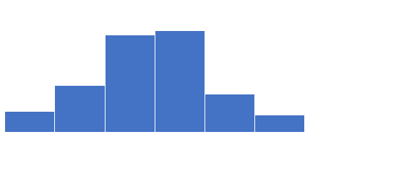
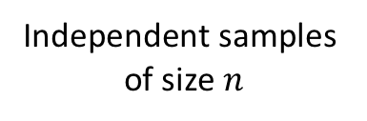
Population
Sample 1
Sample $∞$
Sample ∞
Sample 2
$$…$$
…
$$…$$
…
$${\hat{θ}}_{2}$$
𝜃 ̂_2
$${\hat{θ}}_{1}$$
𝜃 ̂_1
$${\hat{θ}}_{∞}$$
𝜃 ̂_∞
Independent samples of size $n$
Sampling distribution of $\hat{θ}$

Slide 3
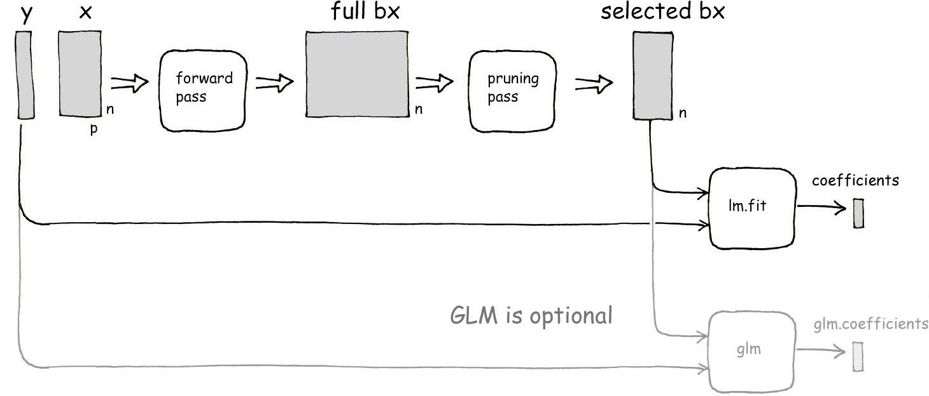

Slide 4
Fold 1
Fold 2
Fold 3
Fold 4
Fold 5
Full set of training data
Test
Train
Train
Train
Train
Fold 1 performance
Averaged performance
Train
Test
Train
Train
Train
Fold 2 performance
Train
Train
Test
Train
Train
Fold 3 performance
Train
Train
Train
Test
Train
Fold 4 performance
Train
Train
Train
Train
Test
Fold 5 performance

